Slide 1
ROAD SIGN DETECTION USING MACHINE LEARNING
Team Members:
1.Mohamed Thoufik U (811721104069)
2.Sundaramanickam N (811721104107)
3.Thamij Ahamed M (811721104113)
Guided By:
Mrs.R.Sathya M.E.,(Ph.D)

Slide 2
Content
1.Objective
2.Problem Statement
3.Existing System
4.Proposed System
5.Architecture
6.Literature Survey

Slide 3
Objective
To Develop and implement a robust machine learning model capable of accurately detecting and classifying various types of road signs from images.
To enhance autonomous driving systems, improve road safety, and assist in real-time navigation for drivers.

Slide 4
Problem Statement
In the context of modern transportation and autonomous driving systems, there exists a critical need for accurate and efficient road sign detection and classification.
Despite advancements in computer vision, the detection of road signs under varying lighting conditions, weather, and occlusions remains a challenging task.

Slide 5
Existing System
In the existing system, road sign detection is primarily based on traditional computer vision techniques, which often lack accuracy and robustness under varying conditions.
These methods typically involve handcrafted features, such as color, shape, and texture, followed by classification using machine learning algorithms.
The limitations of the existing system include:
1.Limited Accuracy
2.Performance
3.Scalability

Slide 6
Proposed System
The proposed system aims to leverage the power of deep learning and convolutional neural networks (CNNs) to overcome the limitations of the existing system.
The key features and improvements of the proposed system are:
1.Deep Learning-based Detection
2.Multi-class Classification
3.User-Friendly Interface

Slide 7
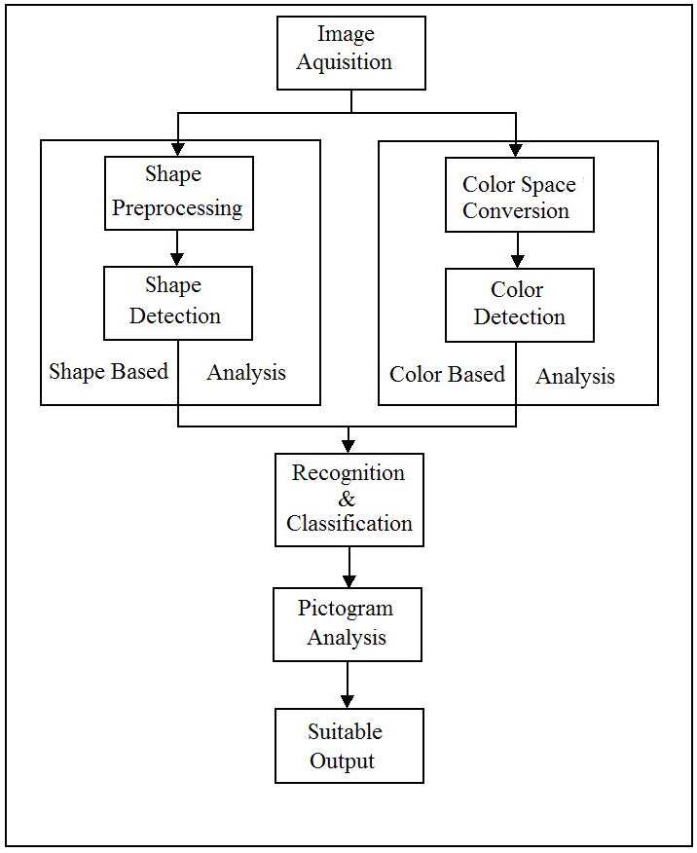
Architecture

Slide 8
Modules
1.Sensors for Road Detection
2.Techniques and Algorithm
3.Challenges in Road Sign Detection
4.Application
5.Techniques for improvement

Slide 9
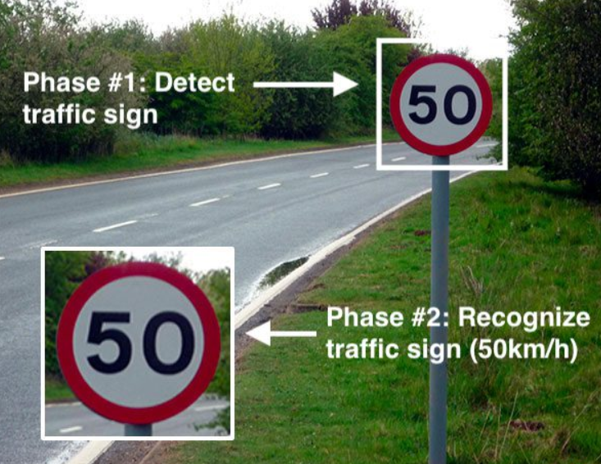
Sample Output

Slide 10
Future Enhancements
Advanced neural networks, such as deeper architectures and attention mechanisms, could enhance the system’s .
Future enhancements for road sign detection systems can focus on improving detection accuracy, robustness, and integration with autonomous driving technologies.

Slide 11
Literature Survey
S.NO | TITLE | AUTHORS | YEAR | TECHNIQUES USED | ALGORITHM USED | MERITS | DEMERITS
1. | Traditional Methods for Road Sign Detection | Bahlmann, C., Haas, N., & Kollnig, H. | 2005 | Color segmentation | Handcrafted feature extraction and classification | Simple and computationally less intensive | Limited accuracy under varying conditions
2. | Deep Learning Approaches for Road Sign Detection | Sermanet, P., Eigen, D., Zhang, X., Mathieu, M., Fergus, R., & LeCun, Y. | 2011 | Shape analysis | OverFeat Architecture | Improved accuracy compared to traditional methods | Requires large labeled datasets for training

Slide 12
Literature Survey
S.NO | TITLE | AUTHORS | YEAR | TECHNIQUES USED | ALGORITHM USED | MERITS | DEMERITS
3. | Traffic Sign Recognition Datasets | Houben, S., Stallkamp, J., Salmen, J., & Schlipsing, M. | 2013 | Dataset creation and annotation | N/A | Provides benchmark datasets for evaluation | Limited to specific regions/countries
4. | Real-time Road Sign Detection Systems | Maldonado-Bascon, S., Lafuente-Arroyo, S., Gil-Jimenez, P. | 2016 | Embedded GPU acceleration | Real-time detection algorithms optimized for GPUs | Achieves real-time performance | Limited by the computational power of embedded GPUs

Slide 13
Literature Survey
S.NO | TITLE | AUTHORS | YEAR | TECHNIQUES USED | ALGORITHM USED | MERITS | DEMERITS
5. | Transfer Learning for Road Sign Detection | Zhang, Z., Zhang, X., Liu, Y., & Wang, L. | 2018 | Transfer learning | Pre-trained deep learning models | Faster training and convergence | May require large computational resources for fine-tuning
6. | Challenges and Future Directions | Ardeshir, M., & Javidi, M. M. | 2019 | Survey and analysis of existing methods | N/A | Comprehensive overview of challenges and solutions | Limited to qualitative analysis

Slide 14
THANK YOU

